Slide 1
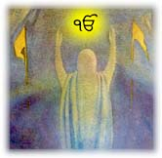
Suchaji Jeewan Jaach
Notes:
The humanity has been blessed with the spiritual gift of SGGS by Almighty. The universal and humanitarian concept enshrined in SGGS integrates the humanity at large, renders clarity of cosmic creation of which humans happen to be a small though significant ingredient. There are various aspects that establish that Gurbani of SGGS integrates humans irrespective of their nationality, caste and creed.

Slide 2
wB[Zy dh f}zdrh ihT{D dh sKx
wB[Zy oZi e/ f}zdrh B{z wkBDk ukj[zdk j?
wB[Zy B{z oi/tK ukjhdk j?
oZi/ j'J/ B{z jh okik efjzd/ jB
jo e'Jh okik j'Dk ukj[zdk j?

Slide 3
sKx g{oh eoB dh sVg
jo e'Jh y'i fojk j?
jo e'Jh sbkF eo fojk j?
sbkF eoB bJh fJB;kB B/ nkgDhnK fJzdqhnK dh Fesh dk fJ;s/wkb ehsk
fJB;kB B/ fi; pko/ ;[fDnk, T[; tZb GZfink
fJB;kB d/ i' B}ohA fgnk T[E/ ngfVnk

Slide 4
}whB dh y'i
fJB;kB dk gfjbk fXnkB T[; }whB tZb frnk fiE/ T[j ofjzdk j?
fijVh }whB T[;B{z ghVh-do-ghVh nzB gqdkB eo ojh j?
fJB;kB B/ }whB B{z wZb e/ okik j'D dk dkntk ehsk
go fJB;kB okik BjhA pD ;fenk

Slide 5
}whB d/ Gzvko/ gqkgs eoB s/ th fJB;kB dk oZi BjhA j'fJnk
fJB;kB dh M'bh Go BjhA ;eh
}whB ns/ }whB d/ sZs fwbD s/ th fJj ezrkb jh fojk

Slide 6
fco T[; B{z gjkV B}ohA gJ/
}whB Bkb'A id'A fJB;kB dk fYZv Bk Gfonk sK fJB;kB B/ gjkVK d/ ;hB/ uho/
gjkVK ftu'A fJB;kB B{z pj[s e[M bZfGnk
b'jk bZfGnk, sKpk bZfGnk, e'bk bZfGnk
;'Bk, uKdh ns/ jho/ bZG/

Slide 7
nkgDk xo, nkgDk sB ;'B/ d/ rfjfDnK Bkb ;ik fbnk
jho/ nkgD/ ski ftu iV bJ/
go fJB;kB ezrkb dk ezrkb jh fojk

Slide 8
fco T[; dh sbkF T[; B{z ;kro d/ sb #s/ b? rJh
fJB;kB B/ ;kro d/ gkDhnK B{z SkfDnk
;kro ftub/ GKs-GKs d/ gqkDh ns/ sZs gqkgs ehs/
;kroK B{z th wZb fbnk
go fJB;kB dh M'bh fco th ykbh ojh

Slide 9
fJB;kB dhnK fBrkjK nk;wkB sZe gj[zuhnK
nopK$yopK o[gJ/ d/ you/ eoe/ fJB;kB uzdqwK s/ gj[zu frnk
uzB s/ T[jh uzB ukVQ/ fijV/ Xosh s/ ukVQdk j?
uzdqwK dh o/s sK n;hA fJeZso eo fbnkJ/ go nkgD/ nzdo dh Jhoyk, dP?s-GktBk d/ gqshe tZy-tZy w[beK d/ Mzv/ T[E/ M{bd/ SZv e/ nkJ/
j[D fJB;kB dhnK fBrkjK j'o nrKj s'A nrKj ik ojhnK jB

Slide 10
fJB;kB j[D th ezrkb feT[A j?
n? pzd/ ! }whB B{z s{z y'fink
n;wkB ;kro s{z y'fink
gjkVK B{z s{z uhfonk
go s{z fsqgs BjhA j' ;fenk, oZi BjhA ;fenk

Slide 11
nfijk feT[A <
n;b ftu s{z pkjow[Zyh jh pfDnk fojk
gjkVK dh y'i bJh pkjow[Zyh j'Dk g?Adk j?
;kro dh e[Zy'A w'sh eZYD bJh th pkjow[Zyh j'Dk g?Adk j?

Slide 12
fco fJB;kB eo/ eh <
nkgD/ wB ftu Mksh wko
pzd/ y'i fdb jo o'i Bk fco go/FkBh wkfj
fJ; wB eT[ e'Jh y'ij[ GkJh
gjkVK, XoshnK, ;kroK ns/ n;wkBK dh y'i bJh pkjow[Zyh j'Dk g?Adk j? go oZph y}kBk gqkgs eoB bJh nzsow[Zyh j'Dk g?Adk j?

Slide 13
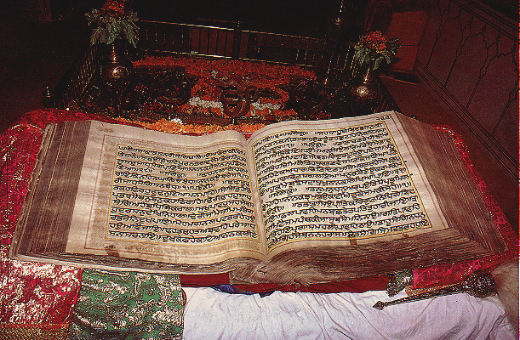

Slide 14
nzsow[Zyh j'D Bkb eh j't/rk <
pqfjwzv dh y'i Bkb gdkoE jZE bZr/ B/
wB dh y'i Bkb gqwkswk jZE bZr/rk
;kro ftu'A w'sh fwb/ B/
wB d/ ;kro ftu'A frnkB fwb/rk
gjkVK dh y'i eofdnK Xks{nK fwbhnK jB
wB dh y'i eofdnK ;e{B fwb/rk.

Slide 15
}whB ftu'A s?B{z nzB fwfbnk j?, XzB fwfbnk j?
wB ftu'A s?B{z fsqgsh fwb/rh, oi/tK fwb/rk
uzdqwK s'A s{z w[Zmh Go o/s fbnkfJnk j?A
wB ftu'A nd[Zsh y}kB/ bZGDr/, s{z wkbkwkb j' ikJ/Ark
fJT[A s{z okik pD ikJ/Ark, wjkokik pD ikJ/Ark
wB y'is Bkw[ BT[ fBfX gkJh..

Slide 16
E'Vk fijk nzsow[Zyh j'D tkbk
eftsk, rhs, ;zrhs d/ ekpb j' iKdk j?
wB d/ fJe e'B/ ftu got/F eofdnK eth pD frnk
wB d/ d{i/ e'B/ ftu got/F ehsk-;zrhseko pD frnk
dkoFfBe j' frnk, fcbk;co j' frnk, fuzse j' frnk

Slide 17
go wB sK e[okj/ gkT[Ad? !
i/eo wB nzdo tV/ fpBK e/tb Mks wkohJ/ sK wB nzdo ekw j?, b'G j?, nzjeko j?
fJj T[;/ soQK j? fit/A bfjoK ;kro d/ T[go- T[go B/, sfj ftu BjhA, rfjokJh ftu BjhA
;koh GZi d"V ;kro d/ T[go T[go j?
EZb/ sK ;e{B j?, FKsh j?, fJekorsk j?

Slide 18
;kro dh T[Sbh j'Jh nt;Ek B{z s{\kB efjzd/ jB
wB dh T[Sbh j'Jh nt;Ek B{z ekw efjzd/ jB
wB dh T[Sbh j'Jh nt;Ek B{z b'G efjzd/ jB
wB dh T[Sbh j'Jh nt;Ek B{z njzeko efjzd/ jB
b'G bfjo nfj BhMo pki? (Bkwd/t ih, gzBk 1196)
;kro d/ ezY/ s/ f;ZghnK, ;zy gJ/ fwbd/ jB
rfjokJh ftu w'sh jB, feBko/ s/ w'sh BjhA fwbd/
;w[zd ;kj ;[bskB frojk ;/sh wkb[ XB[..

Slide 19
But the reality is..
iehu mnUAw iKnu n itkY bhu rMgI dh dh idis cil cil hwFy ]
nw mnu mrY n kwrju hoie ]
mnmuK mMnu Aijqu hY dUjY lgY jwie ]
iqs no suKu supnY nhI duKy duiK ivhwie ]

Slide 20
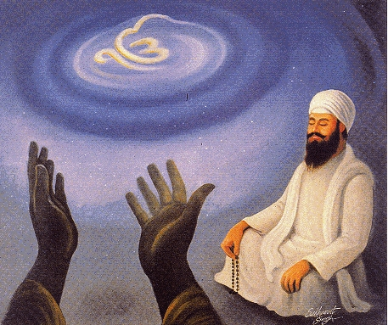
duie kr joiV krau Ardwis ]
quDu BwvY qw Awxih rwis ]

Slide 21
socY soic n hoveI jy socI lK vwr ] cupY cup n hoveI jy lwie rhw ilv qwr]
BuiKAw BuK n auqrI jy bMnw purIAw Bwr ]
Sheer Rituals Won't Help

Slide 22
Coif isAwxp sgl mnu qnu Arip Dir ]
icMqw Cif AicMqu rhu nwnk lig pweI ]
AwigAw qumrI mITI lwgau kIE quhwro Bwvau ]
jo qU dyih qhI iehu iqRpqY Awn n kqhU Dwvau ]

Slide 23
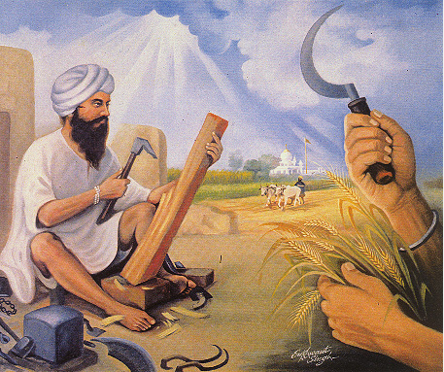
ikrq ivrq kr Drm dI

Slide 24
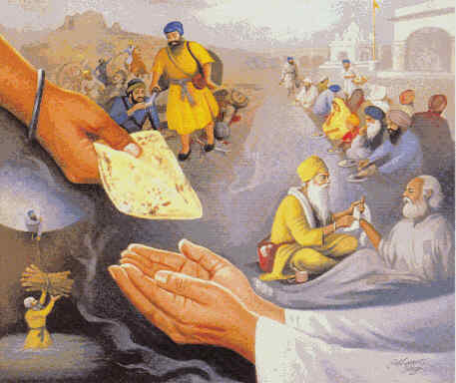

Slide 25
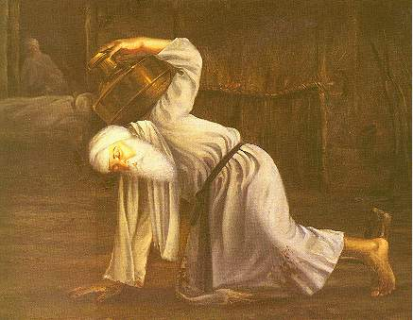

Slide 26
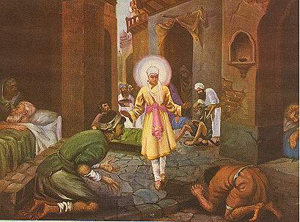

Slide 27
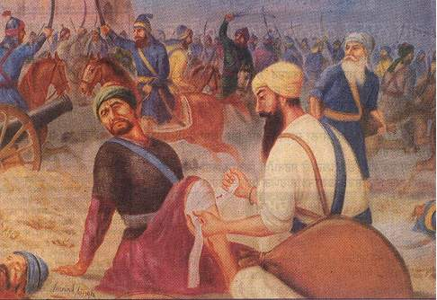

Slide 28
